Slide 1
Illustrating System Entity Structure For Building Simulation
Bernard Zeigler
RTSync Corp
ACIMS
C4I Center, GMU
April 2011

Slide 2
Traditional Simulation Development (From Goldstein DEVS Tutorial)
The code consists of five parts: the model parameters, which are normally supplied by the user; the initialization of a set of changing variables known as the state; a simulation loop; the state transition, which occurs repeatedly within the loop; and the simulation output, which in this case also occurs within the loop.

Slide 3
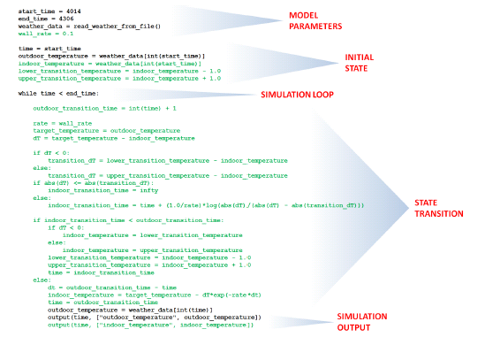
Traditional Simulation Development (From Goldstein DEVS Tutorial)
the basic structure of the program remains.
The thing to note is that the added code, shown in green, is scatteredn throughout the program.

Slide 4
DEVS Simulation Development (From Goldstein DEVS Tutorial)
Using DEVS, simulation software is divided into a model and a simulator.
Just like the traditional approach, DEVS-based simulation development is an iterative process. The difference is that, because a DEVS simulator can be reused for a variety of different models, the developer modifies only the model at each iteration.
Aside from enforcing a distinction between the model and the simulator, DEVS allows complex models to be composed of simpler component models.

Slide 5
Coupled DEVS Model (From Goldstein DEVS Tutorial)
A DEVS model generally deals with model parameters, the initial state, state transitions, and simulation output, but the simulation loop itself is part of the simulator.
DEVS models are either atomic or coupled, and coupled models include various
interconnected component models.
Using DEVS, each enhancement requires modifications to only certain component models; this encourages collaboration.

Slide 6
DEVS-Based Modeling & Simulation
System Entity Structure accepted by Building Simulation Community
Structural Description
Combine structure and component behavior
Generate Model and Simulator
System
Behavior Descriptions
Models provided by the Building Simulation Community – preferable DEVS-compliant

Slide 7
Introducing the System Entity Structure (SES)
The SES takes collaborative DEVS model development a major step further
The SES enables the description of families of hierarchical models such as a range of architectures for building simulations
The SES supports the development of model repositories where components developed by developers and vendors can be stored for reuse
A building architect/designer can prune the SES for a particular architecture and by transforming, evaluate it for various objectives such as energy consumption
DEVS/SOA goes an additional step to support discovery and model composition using resources of the web

Slide 8
SES Formal Framework
The System Entity Structure (represents a design space via the elements of a system and their relationships in hierarchical and axiomatic manner
Aspect : labeled decomposition relation between the parent and the children
System Entity Structure
Specialization :labeled relation that expresses alternative substitutions for a component
A
B
C
B1
B2
D
E
F
Multi-aspects: aspect for which the components are all of the same kind.
DS
F1
F2
F3
Pruning
Pruned Entity Structure 1
Pruned Entity Structure 2
Pruning: cuts off structure in a SES that is not needed to meet particular objectives
Selects from a family of possible architectures
A
A
B:B2
C
B:B1
C
D
E
F:F1
D
E
F:F3
D
D
D
D
D
D

Slide 9
Basic Infrastructure
Pruning
Transformation
SES
PES
Car 1
Car 1
Engine:
Gasoline
Engine
Transmission: Automatic
Transmission
Chassis:
Rear Wheel
Chassis
Car 1
Engine:
Gasoline
Engine
Transmission: Automatic
Transmission
Chassis:
Rear Wheel
Chassis
Car 1
Simulation Model
6 Cyl
Engine
Engine:
Gasoline
Engine
Transmission: Automatic
Transmission
Chassis:
Rear Wheel
Chassis
Car 1
6 Cyl
Engine
Engine:
Gasoline
Engine
Transmission: Automatic
Transmission
Chassis:
Rear Wheel
Chassis
6 Cyl
Engine
6 Cyl
Engine
Engine:
Gasoline
Engine
Transmission: Automatic
Transmission
Chassis:
Rear Wheel
Chassis
6 Cyl
Engine
Objective
Model Base
Experimental
Frames
External
Transition
State
State
State
State
Internal
Transition
External
Transition
State
State
State
State
Internal
Transition
External
Transition
State
State
State
State
Internal
Transition
Experimental Frame Model
State
State
State
State
State
State
State
State
State
time advance
output
time advance
output
time advance
output
External
Transition
State
State
State
State
State
State
State
Internal
Transition
External
Transition
State
State
State
State
State
State
State
Internal
Transition
External
Transition
State
State
State
State
State
State
State
Internal
Transition
time advance
output
time advance
output
time advance
output
External
Transition
State
State
State
State
State
State
State
Internal
Transition
External
Transition
State
State
State
State
State
State
State
Internal
Transition
External
Transition
State
State
State
State
State
State
State
Internal
Transition
External
Transition
State
State
State
State
State
State
State
Internal
Transition
External
Transition
State
State
State
State
State
State
State
Internal
Transition
External
Transition
State
State
State
State
State
State
State
Internal
Transition
time advance
output
time advance
output
time advance
output
time advance
output
time advance
output
time advance
output
External
Transition
State
State
State
State
State
State
State
Internal
Transition
External
Transition
State
State
State
State
State
State
State
Internal
Transition
External
Transition
State
State
State
State
State
State
State
Internal
Transition
time advance
output
time advance
output
time advance
output
External
Transition
State
State
State
State
State
State
State
Internal
Transition
External
Transition
State
State
State
State
State
State
State
Internal
Transition
External
Transition
State
State
State
State
State
State
State
Internal
Transition
time advance
output
time advance
output
time advance
output

Slide 10
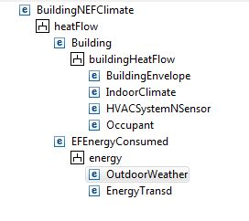
System Entity Structure for Building and Experimental Frame

Slide 11
NL Specification of System Entity Structure for Building and Experimental Frame
From the heatFlow perspective, BuildingNEFClimate is made of Building and EFClimate !
EFClimate can be OutdoorTempSeries or OutdoorTempGenr in meansOfGeneration !
From the heatFlow perspective, EFClimate sends OutdoorTemp to Building !
From the buildingHeatFlow perspective, Building is made of BuildingEnvelope, IndoorClimate, HVACSystemNSensor,and Occupant !
From the buildingHeatFlow perspective, Building sends OutdoorTemp to BuildingEnvelope!
From the buildingHeatFlow perspective, BuildingEnvelope sends OutdoorHeatTransfer to IndoorClimate!
From the buildingHeatFlow perspective, HVACSystemNSensor sends HVACHeatTransfer to IndoorClimate!
From the buildingHeatFlow perspective, IndoorClimate sends IndoorTemp to Occupant !
From the buildingHeatFlow perspective, IndoorClimate sends IndoorTemp to HVACSystemNSensor!
From the buildingHeatFlow perspective, Occupant sends WindowChange to BuildingEnvelope!
BuildingEnvelope can be WithWindow or WithoutWindow in opening !
From the control perspective, HVACSystemNSensor is made of HeatCoolSystem, Ventillator, and TempSensor !
From the control perspective,HVACSystemNSensor sends IndoorTemp to TempSensor !
From the control perspective,TempSensor sends SensorChange to HeatCoolSystem!
From the control perspective,HeatCoolSystem sends HVACHeatTransfer to HVACSystemNSensor !
HeatCoolSystem can be HeaterNCooler or HeatPump in operation !
From the onOff perspective,HeaterNCooler is made of Heater and Cooler !
From the onOff perspective,HeaterNCooler sends SensorChange to Heater !
From the onOff perspective,HeaterNCooler sends SensorChange to Cooler !
From the onOff perspective, Heater sends HVACHeatTransfer to HeaterNCooler !
From the onOff perspective, Cooler sends HVACHeatTransfer to HeaterNCooler !

Slide 12
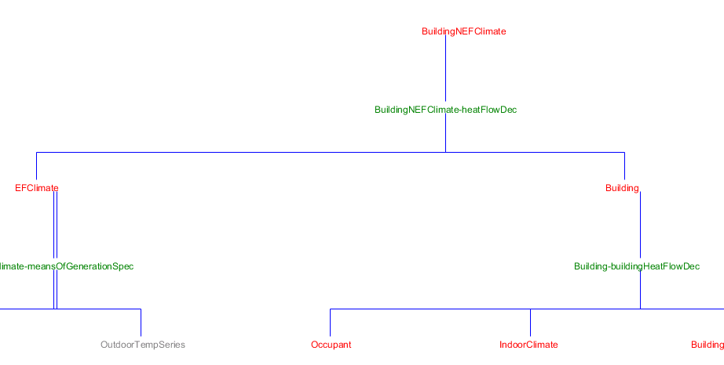
Top 3 Levels of Building and EF SES
Coupling

Slide 13
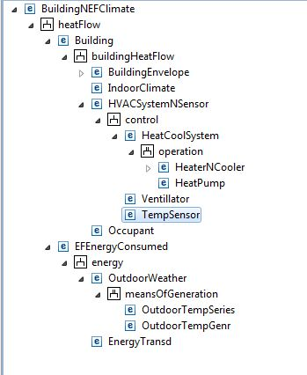
SES Showing Specializations
Specialization for choice of HeatNCool System
Specialization for choice of outdoor weather source

Slide 14
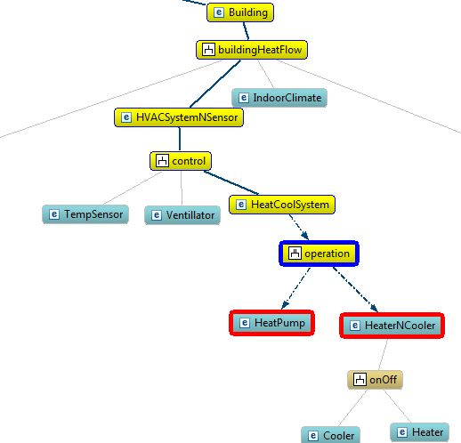
Pruning Entities From Specializations
selectEntityFromSpec("HeaterNCooler", “..“..");
selectEntityFromSpec("HeatPump", "operation", "HeatCoolSystem");

Slide 15
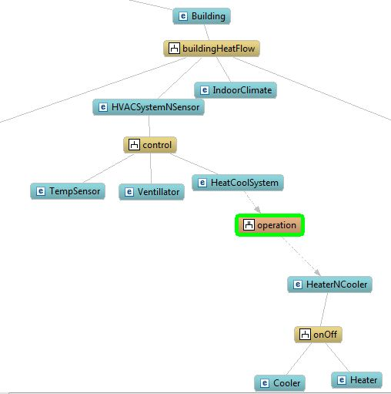
Pruning of SES where Separate Heater and Cooler are Selected

Slide 16
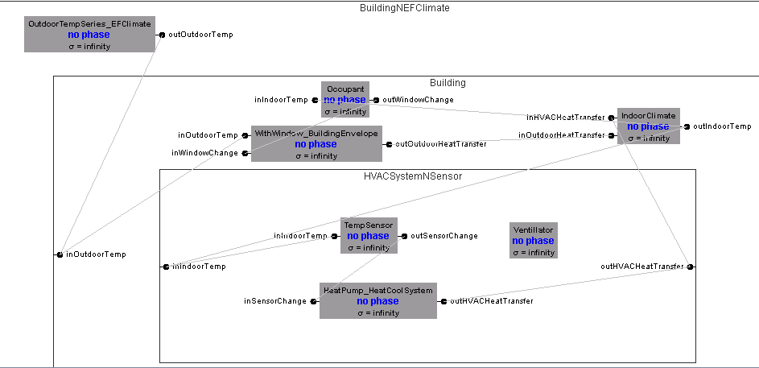
Transformation of SES where Heat Pump Selected

Slide 17
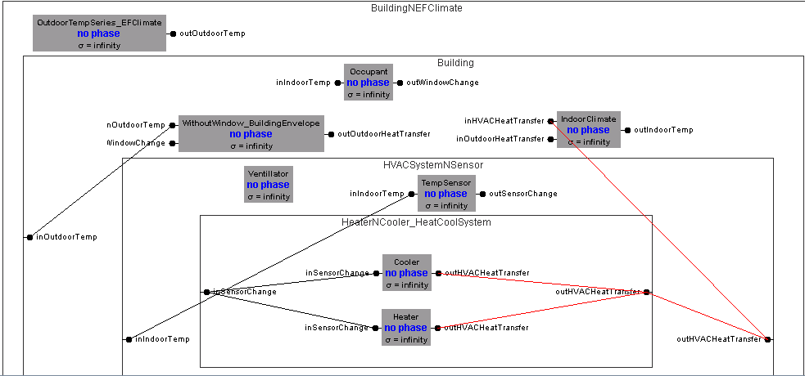
Transformation of SES where Separate Heater and Cooler Selected

Slide 18
Refinement of Experimental Frame to include Energy Consumption Transducer
From the heatFlow perspective, BuildingNEFClimate is made of Building and EFEnergyConsumed !
From the heatFlow perspective, EFEnergyConsumed sends OutdoorTemp to Building !
From the heatFlow perspective, Building sends HVACHeatTransfer to EFEnergyConsumed !
From the energy perspective, EFEnergyConsumed is made of OutdoorWeather and EnergyTransd !
OutdoorWeather can be OutdoorTempSeries or OutdoorTempGenr in meansOfGeneration !
From the energy perspective, OutdoorWeather sends OutdoorTemp to EFEnergyConsumed !
From the energy perspective, EFEnergyConsumed sends HVACHeatTransfer to EnergyTransd !
//rest of SES is same as before

Slide 19
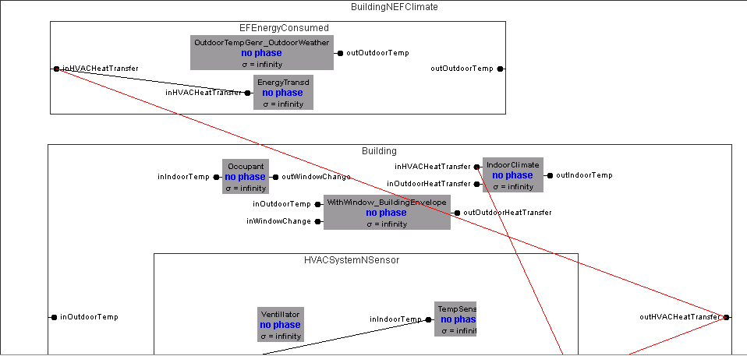
Pruned SES showing Refined EF for Consumption

Slide 20
DEVS/SOA combines DEVS with SOA
Simulation, Web Service, Geographic, Ontology Standards
External Web Service-Based Models:
DEVS Web Service Proxies:
Model Integration
Simulation
Coordinator
Expanding Capabilities
DEVS Compliant Models
DEVS/SOA is an open architecture with expanding capabilities to exploit simulation
resources on the Web

Slide 21
The Creative Generative World of Pruning
Constraints may apply to aspects (compositions) and selections (specializations)
Constraint propagation – a selection in one place may constrain the choices in another place – can be rule based
Context dependence – selections from the same specialization can be different in different contexts (under different entities)
MultiAspects open up new contexts for pruning

Slide 22
Books and Web Links
www.acims.arizona.edu
Rtsync.com
http://en.wikipedia.org/wiki/DEVS

